Slide 1

Cartpole Swing-Up using DQN & DDPG
Mayuran Surendran, Dominik Urbaniak
Technische Universität München
Department of Electrical and Computer Engineering
Chair of Human-Centered Assistive Robotics
Munich, 12 February 2020

Slide 2
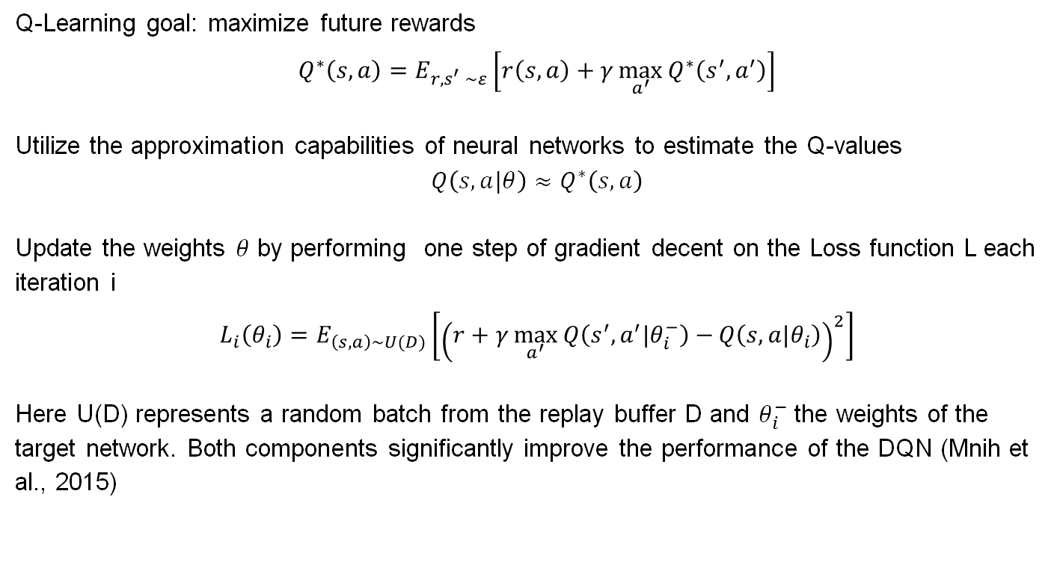
Deep Q Networks (DQN)
Q-Learning goal: maximize future rewards
$$Q^{∗}\left(s,a\right)=E_{r,s^{′} \sim ε}\left[r\left(s,a\right)+γ\max_{a^{′}}{Q^{∗}\left(s^{′},a^{′}\right)}\right]$$
Utilize the approximation capabilities of neural networks to estimate the Q-values
$$Q\left(s,a|θ\right)≈Q^{∗}\left(s,a\right)$$
Update the weights $θ$ by performing one step of gradient decent on the Loss function L each iteration i
$$L_{i}\left(θ_{i}\right)=E_{\left(s,a\right)\sim U(D)}\left[{\left(r+γ\max_{a^{′}}{Q\left(s^{′},a^{′}|θ_{i}^{−}\right)−}Q\left(s,a|θ_{i}\right)\right)}^{2}\right]$$
Here U(D) represents a random batch from the replay buffer D and $θ_{i}^{−}$ the weights of the target network. Both components significantly improve the performance of the DQN (Mnih et al., 2015)

Slide 3
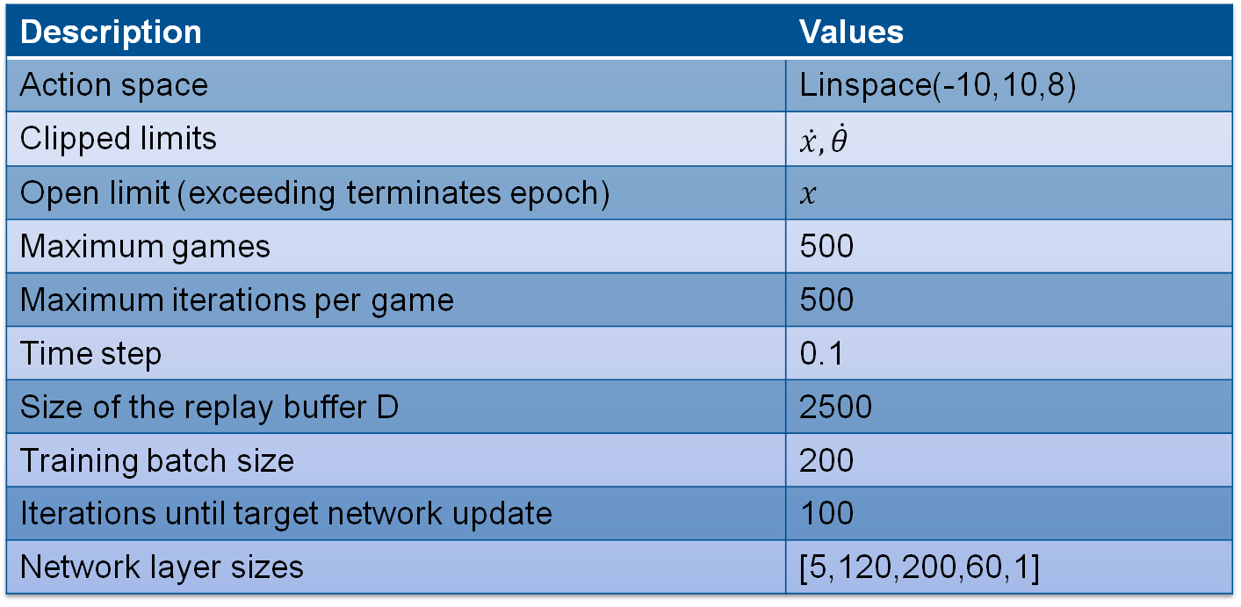
DQN Training parameters
Description | Values
Action space | Linspace(-10,10,8)
Clipped limits | $$\dot{x,}\dot{θ}$$
Open limit (exceeding terminates epoch) | $$x$$
Maximum games | 500
Maximum iterations per game | 500
Time step | 0.1
Size of the replay buffer D | 2500
Training batch size | 200
Iterations until target network update | 100
Network layer sizes | [5,120,200,60,1]

Slide 4
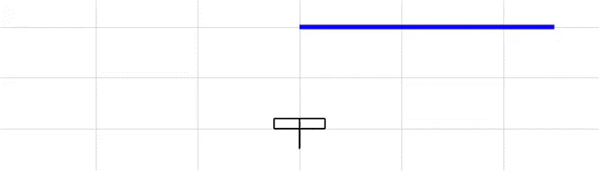
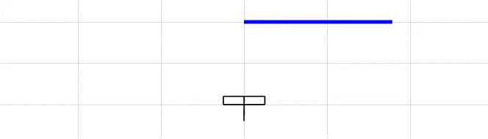
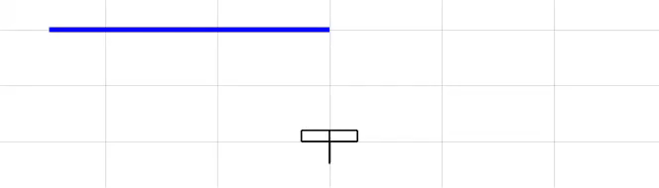
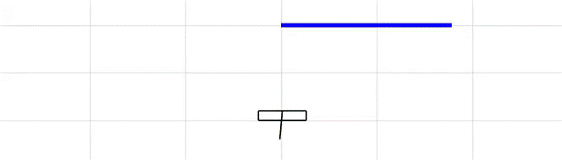

Training with a weighted Reward Function
$$j_{weighted}=\left(\frac{1}{2}x^{2},\sin\left(theta\right),2cos⁡(theta)\right)$$
1) Fails to stay within x-limits
2) Learns to stay within the limits
3) Approaches x=0
4) Final agent
The weighted reward assigns higher priority to holding the pendulum in the upright position

Slide 5
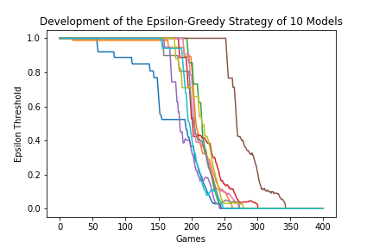
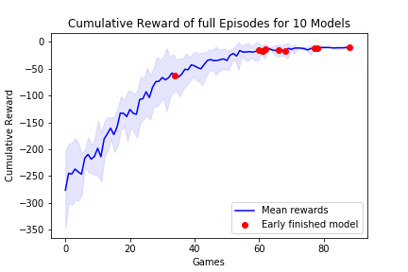
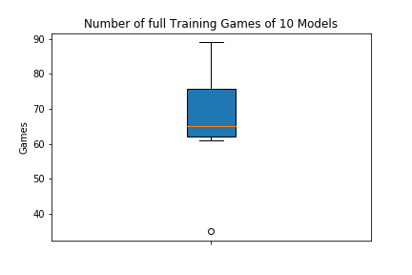
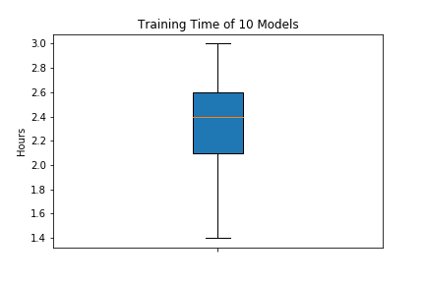
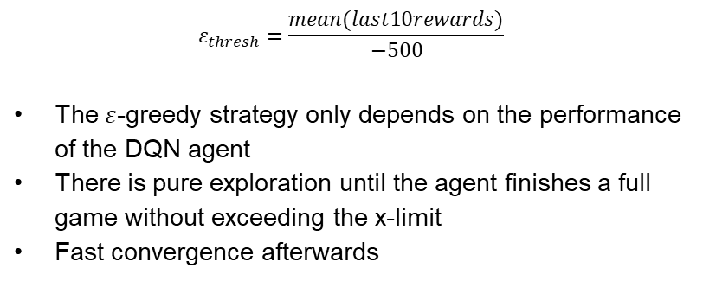
Training Results of 10 Models
$$ε_{thresh}=\frac{mean(last10rewards)}{−500}$$
The $ε$-greedy strategy only depends on the performance of the DQN agent
There is pure exploration until the agent finishes a full game without exceeding the x-limit
Fast convergence afterwards
The number of full games and the training time are correlated
-> Pure exploration for ~170 epochs reduces the overall training time

Slide 6
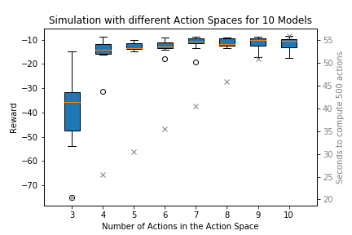
Robustness to different Action Spaces
DQN agent iterates over all possible actions
$$a={argmax}_{a}{Q\left(s,a|θ\right)}$$
The agents can solve the task with less than eight actions

Slide 7
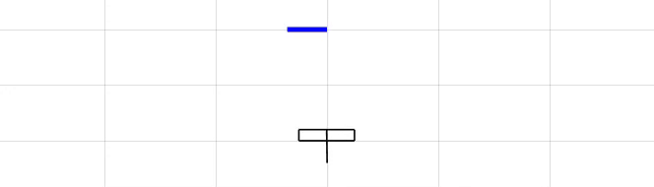
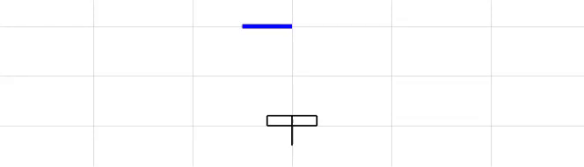
DQN Agent #2
8 actions available
16 actions available
Finer resolution of actions leads to smaller oscillation in x

Slide 8
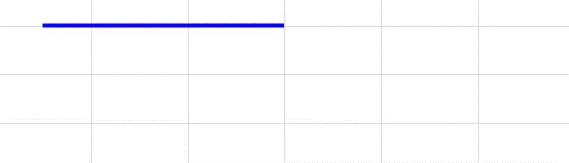
DQN Agent #8
Number of actions: 3
Initial x-position: 8

Slide 9
Deep Deterministic Policy Gradient
Motivation
Most reinforcement learning tasks involve continuous high-dimensional action spaces
Finer discretization of the action space leads to exploding number of actions → Curse of dimensionality
Optimization of action at every timestep using greedy policy too slow and impractical

Slide 10
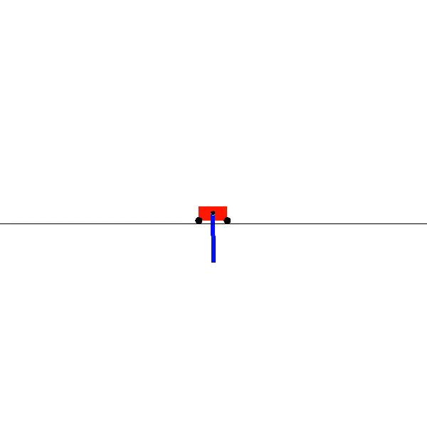
Deep Deterministic Policy Gradient
Simulation of the cartpole swing-up problem

Slide 11
Deep Deterministic Policy Gradient
Simulation of the cartpole swing-up problem
Less oscillation in the direction of the x-axis
The pole is not swung around for full circles

Slide 12
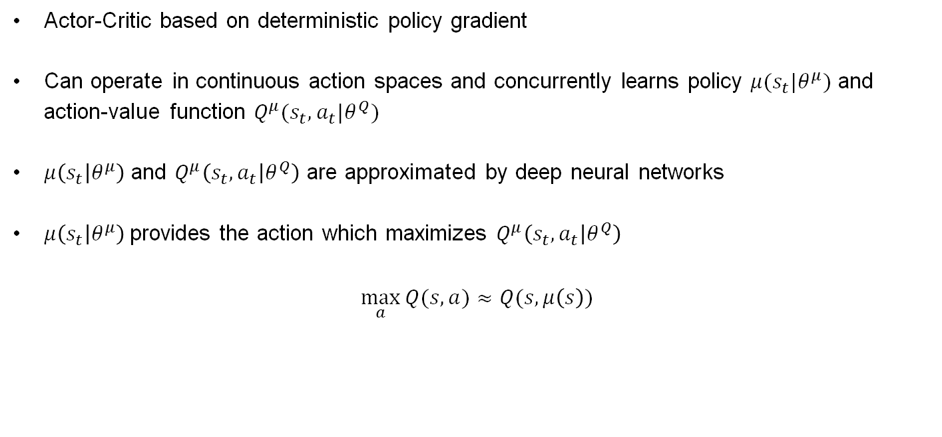
Deep Deterministic Policy Gradient
Solution: Deep Deterministic Policy Gradient
Actor-Critic based on deterministic policy gradient
Can operate in continuous action spaces and concurrently learns policy $μ(s_{t}|θ^{μ})$ and action-value function $Q^{μ}(s_{t},a_{t}|θ^{Q})$
$μ\left(s_{t} | θ^{μ}\right)$ and $Q^{μ}\left(s_{t},a_{t} | θ^{Q}\right)$ are approximated by deep neural networks
$μ\left(s_{t} | θ^{μ}\right)$ provides the action which maximizes $Q^{μ}\left(s_{t},a_{t} | θ^{Q}\right)$
$$\max_{a}{Q(s,a)≈Q(s,μ\left(s\right))}$$

Slide 13
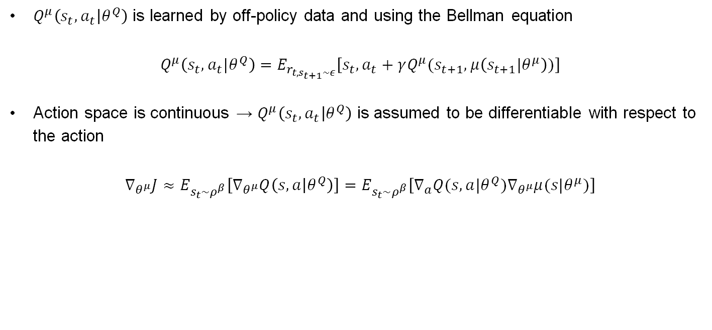
Deep Deterministic Policy Gradient
Solution: Deep Deterministic Policy Gradient
$Q^{μ}\left(s_{t},a_{t} | θ^{Q}\right)$ is learned by off-policy data and using the Bellman equation
$$Q^{μ}\left(s_{t},a_{t}|θ^{Q}\right)=E_{r_{t,s_{t+1}\sim ε}}\left[s_{t},a_{t}+γQ^{μ}(s_{t+1},μ\left(s_{t+1}|θ^{μ}\right))\right]$$
Action space is continuous → $Q^{μ}\left(s_{t},a_{t} | θ^{Q}\right)$ is assumed to be differentiable with respect to the action
$$∇_{θ^{μ}}J≈E_{s_{t}\sim ρ^{β}}\left[∇_{θ^{μ}}Q\left(s,a | θ^{Q}\right)\right]=E_{s_{t}\sim ρ^{β}}\left[∇_{a}Q(s,a|θ^{Q})∇_{θ^{μ}}μ(s|θ^{μ})\right]$$

Slide 14
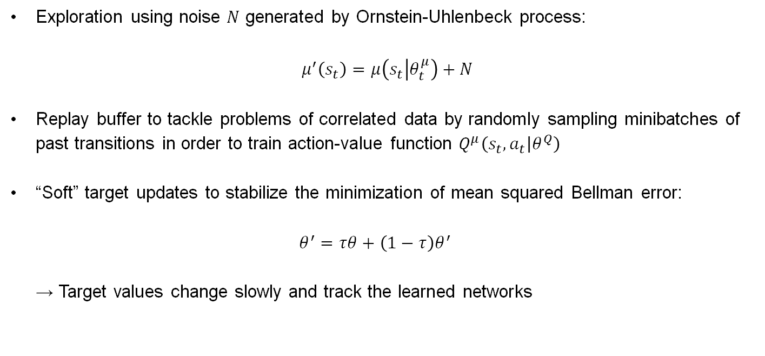
Deep Deterministic Policy Gradient
Implementation
Exploration using noise $N$ generated by Ornstein-Uhlenbeck process:
$$μ^{′}\left(s_{t}\right)=μ\left(s_{t} | θ_{t}^{μ}\right)+N$$
Replay buffer to tackle problems of correlated data by randomly sampling minibatches of past transitions in order to train action-value function $Q^{μ}\left(s_{t},a_{t} | θ^{Q}\right)$
“Soft” target updates to stabilize the minimization of mean squared Bellman error: $θ^{′}=τθ+\left(1−τ\right)θ^{′}$ → Target values change slowly and track the learned networks

Slide 15
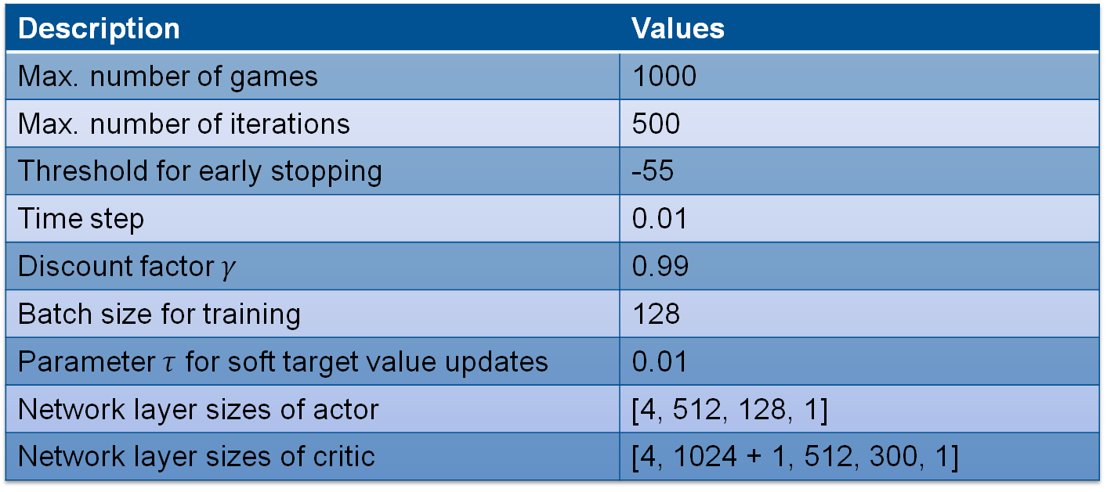
Deep Deterministic Policy Gradient
Implementation – Training Hyperparameters
Description | Values
Max. number of games | 1000
Max. number of iterations | 500
Threshold for early stopping | -55
Time step | 0.01
Discount factor $γ$ | 0.99
Batch size for training | 128
Parameter $τ$ for soft target value updates | 0.01
Network layer sizes of actor | [4, 512, 128, 1]
Network layer sizes of critic | [4, 1024 + 1, 512, 300, 1]

Slide 16
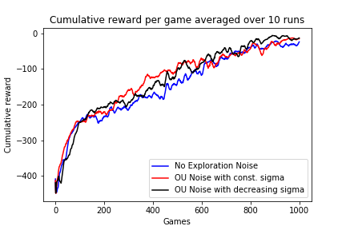
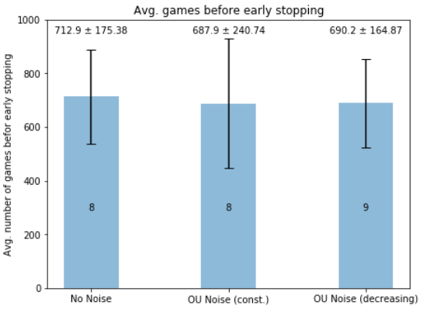
Deep Deterministic Policy Gradient
All three training configurations result in similar training curves with models using exploration noise scoring slightly better
Training using OU noise with decreasing standard deviation leads to a lower average number of games needed for early stopping and a total of nine early stoppings

Slide 17
Deep Deterministic Policy Gradient
Error bar for the second configuration is bigger which indicates that the model is not able to exploit the learned policy resulting in suboptimal actions taken by the agent and ultimately preventing it from early stopping

Slide 18
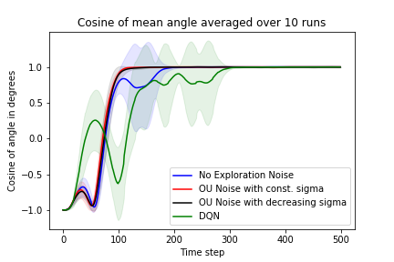
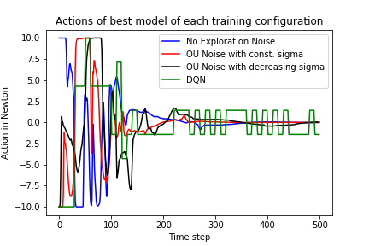
Comparison and Discussion
Two models of DDPG with exploration noise are able to learn the optimal policy
DDPG model without noise learns a suboptimal policy
DQN model learns the optimal policy but takes more run-up to swing up the pole

Slide 19
Comparison and Discussion
DQN agent can only choose a minimum force of 1.4 Newton → During the end of the simulations the agent chooses actions between -1.4 Newton and 1.4 Newton in order to stabilize the pole
DDPG is able to stabilize the pole by applying a smaller range of actions

Slide 20
Conclusion
DQN algorithm achieves a 100% convergence rate when training ten models
DDPG agent achieves a smooth and fast task completion
Both models can be used to solve more complex problems in the field of reinforcement learning

